Slide 1
Sir Isaac Newton
By Maddie Beard

Slide 2
Sir Isaac Newton was born on December 25th, 1642. His father, who was also named Isaac, died three months before his birthday. His mother remarried when Isaac was 3, leaving him to his maternal ( mother's side ) grandmother. He became an amazing student in at The King's School in Grantham, his school before college. In 1653, his mother's second husband died and she returned to Woolsthrope. Isaac also returned. He tried to become a farmer, to fulfill his birthright as a farmer, but he failed, much to his pleasure. As a child, he had always had emotional collapses where he would attack both enemies and friends.

Slide 3
Isaac went back to his school in Grantham, then became an undergraduate at Trinity College, Cambridge. He received financial help from the school. This was 1661. There he developed an interest for astrometry, mathematics, physics, and optics at Cambridge. He developed an interest in advanced science, although he was taught standard curriculum, and he spent his free time reading about the works of modern philosophers.

Slide 4
He had to leave school in 1665 because of an epidemic that lasted until 1667. In 1666, Isaac watched an apple fall. He quotes later, "In the same year I began to think of gravity extending to the orb of the Moon." According to my link, he did not recall this correctly, and he actually came to this conclusion 20 years later.

Slide 5
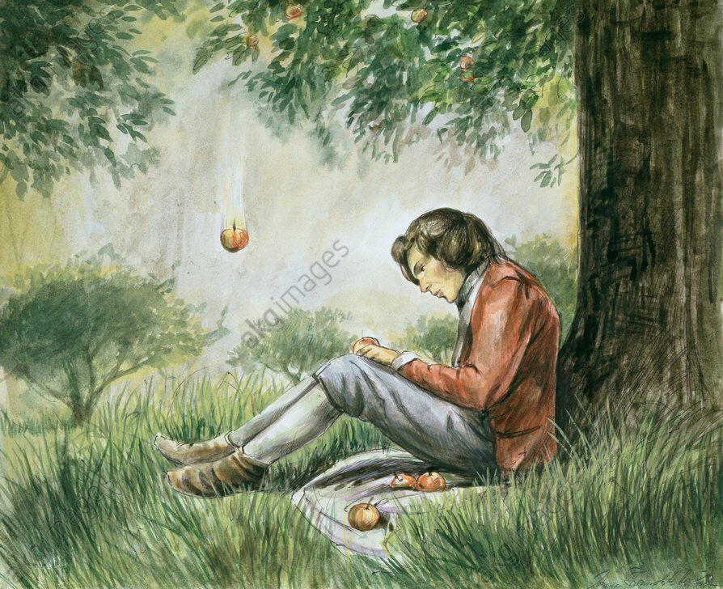
https://www.akg-images.co.uk/Docs/AKG/Media/TR3_WATERMARKED/a/a/2/d/AKG333767.jpg

Slide 6
In April 1667, Isaac returned to Cambridge and was elected a minor fellow. In the next year he became a senior fellow. In 1669 became Lucasian Professor of Mathematics. He was able to continue his studies of optics as a result of this. In 1672, he published a paper about optics. He also met a man named Robert Hooke, who found a pattern in Isaac's behavior.

Slide 7
In August of 1684, Robert Hooke, Edmund Halley and Christopher Wren were struggling with planetary motion. Edmund came and asked Isaac, " What type of curve does a planet describe in its orbit around the sun, assuming an inverse square law of attraction?" Newton answered, "an ellipse". He has actually miscalculated. He had made his conclusion shortly after Robert has sent him letters about planetary motion, a correspondence which Isaac ended quickly.

Slide 8
Edmund had asked Isaac to calculate again, and about two years later, the Philosophiae Naturalis Principia Mathematica was published. Some scientists say this is the most important book in science. Robert Hooke tried to take credit for this, resulting in Isaac holding back the publication date, since it was actually his work. He ended up taking all the credit and deleting Robert's name from everything in the Principia.

Slide 9
In 1689 Isaac was chosen to represent Cambridge in Parliament. In 1696, Isaac was appointed Warden, and soon after, Master of the Mint. Isaac continued to use his power to influence academics. He was president of the Royal Society as well. He used his influence for good and bad. Today we know Isaac Newton mostly for his three laws of motion, which are stated in the Principia. Isaac Newton earned his title of Sir Isaac Newton on April 16th, 1705. He was knighted by Queen Anne for his achievements. Sir Isaac Newton died March 20, 1727.

Slide 10
Sir Isaac Newton's three laws of motion:
Inertia "An object at rest will remain at rest unless acted on by an unbalanced force. An object in motion continues in motion with the same speed and in the same direction unless acted upon by an unbalanced force."
"Acceleration is produced when a force acts on a mass. The greater the mass (of the object being accelerated) the greater the amount of force needed (to accelerate the object)."
" For each action, there is an equal and opposite reaction. "

Slide 11
I used the following websites:
http://users.clas.ufl.edu/ufhatch/pages/01-courses/current-courses/08sr-newton.htm,
http://www.thefamouspeople.com/profiles/isaac-newton-124.php, http://www.isaacnewton.org.uk/essays/Knighthood, http://teachertech.rice.edu/Participants/louviere/Newton/

